Slide 1
Increasing and Decreasing Functions

Slide 3
For a continuous and differentiable function, f, the function values (y-values) are increasing for all x-values where f’(x) > 0, and the function values (y-values) are decreasing for all x – values where f’(x) < 0.

Slide 4
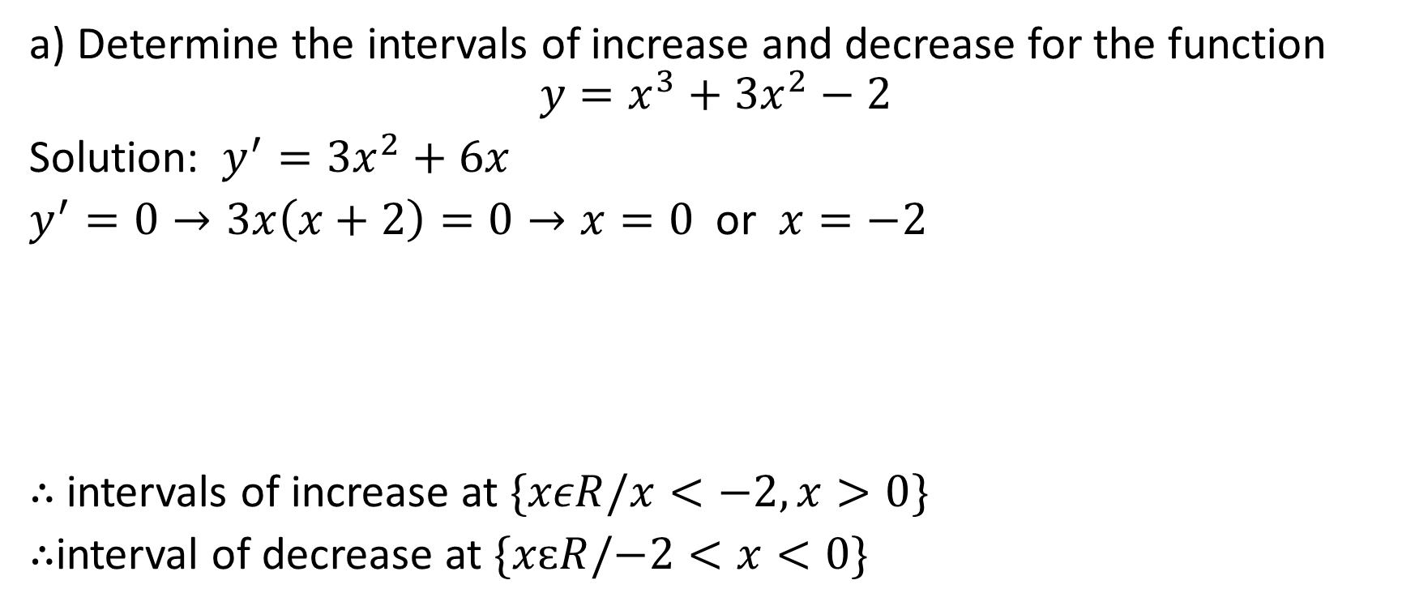


Example 1
a) Determine the intervals of increase and decrease for the function
$$y=x^{3}+3x^{2}−2$$
Solution: $y^{′}=3x^{2}+6x$
$y^{′}=0→3x\left(x+2\right)=0→x=0$ or $x=−2$
$∴$ intervals of increase at $\{xεR/x<−2,x>0\}$
$∴$interval of decrease at $\{xԑR/−2<x<0\}$

Slide 5
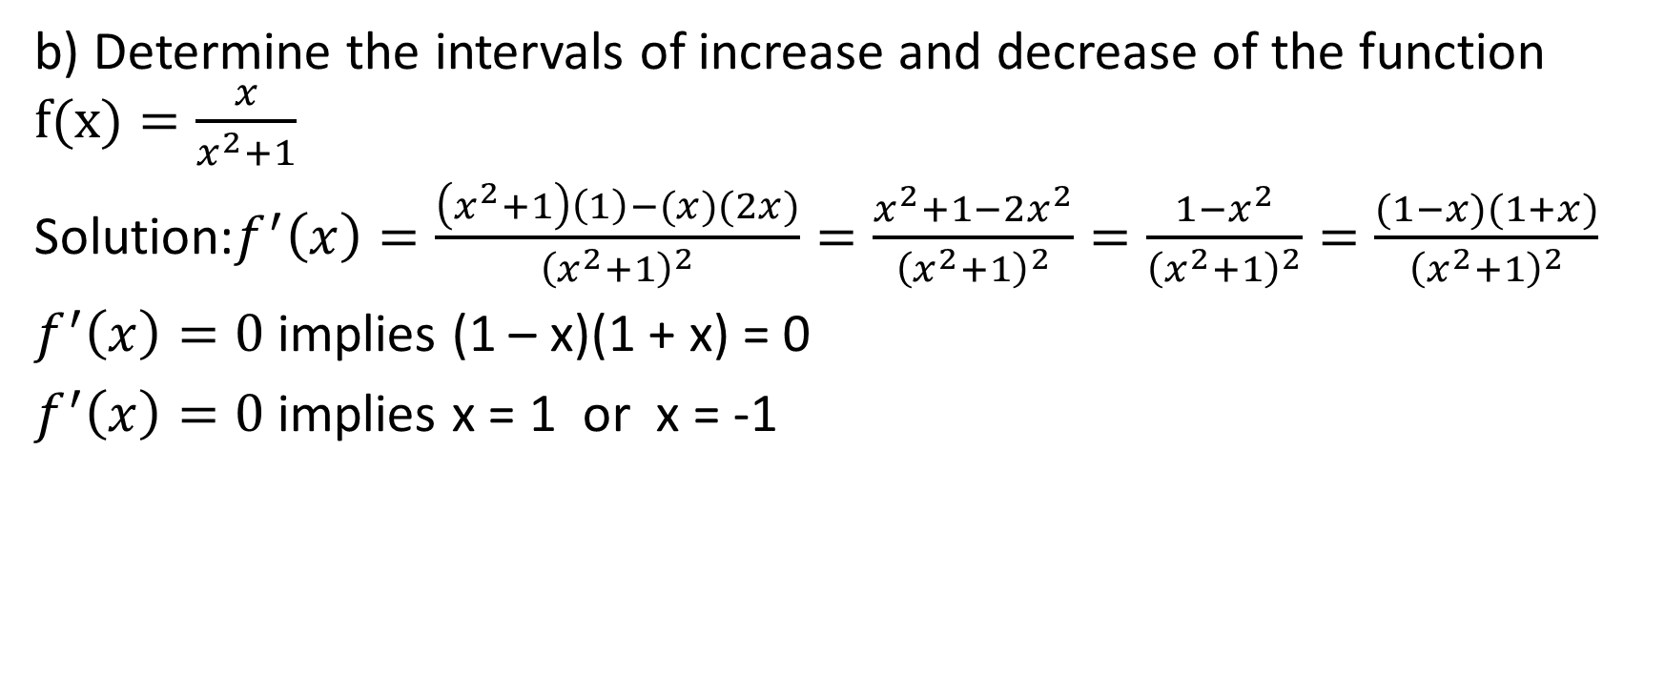
b) Determine the intervals of increase and decrease of the function $f(x)=\frac{x}{x^{2}+1}$
Solution:$f^{′}\left(x\right)=\frac{\left(x^{2}+1\right)\left(1\right)−(x)(2x)}{{\left(x^{2}+1\right)}^{2}}=\frac{x^{2}+1−2x^{2}}{{\left(x^{2}+1\right)}^{2}}=\frac{1−x^{2}}{{\left(x^{2}+1\right)}^{2}}=\frac{(1−x)(1+x)}{{\left(x^{2}+1\right)}^{2}}$
$f^{′}\left(x\right)=0$ implies (1 – x)(1 + x) = 0
$f^{′}\left(x\right)=0$ implies x = 1 or x = -1

Slide 6
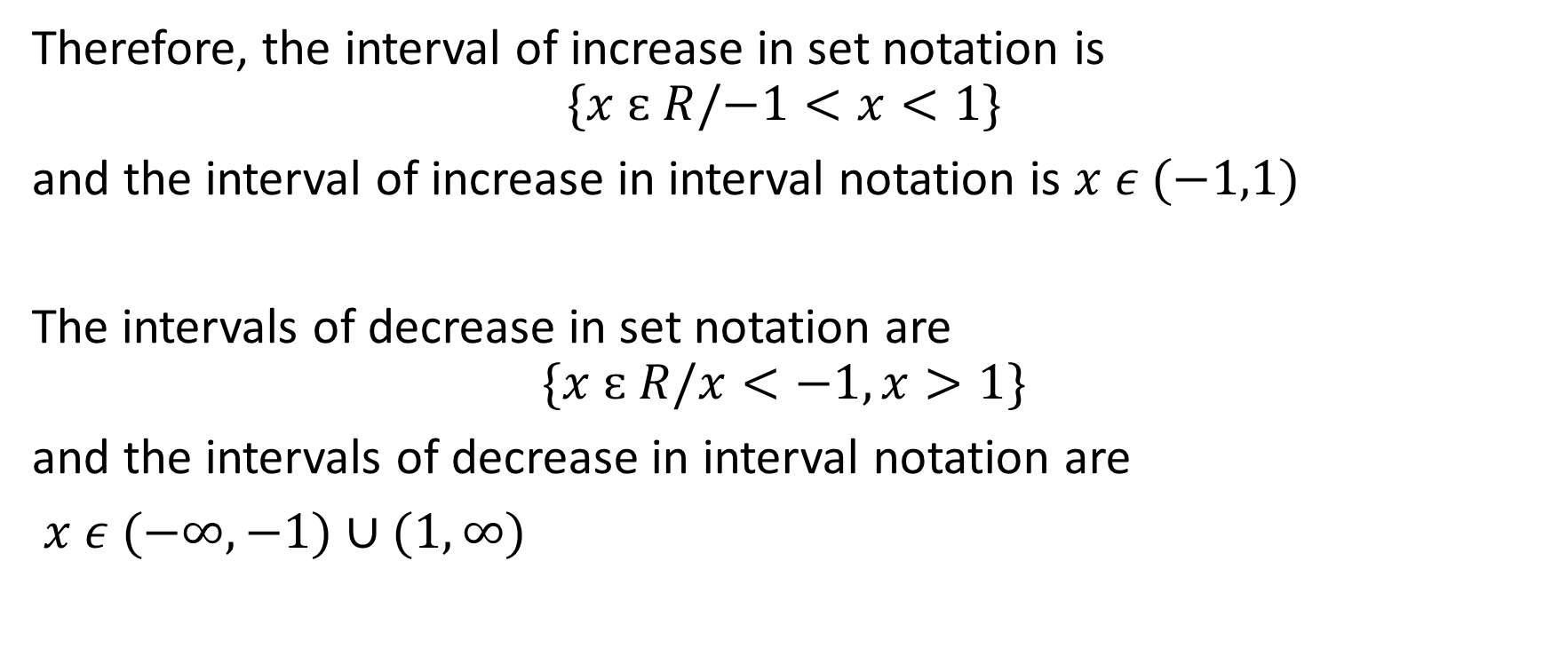
Therefore, the interval of increase in set notation is
$$\{x ԑ R/−1<x<1\}$$
and the interval of increase in interval notation is $x ε (−1,1)$
The intervals of decrease in set notation are
$$\{x ԑ R/x<−1,x>1\}$$
and the intervals of decrease in interval notation are
$x ε (−∞,−1)∪(1,∞)$

Slide 7
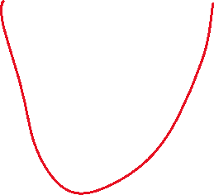
Example 2
Given a graph of y = f’ (x), graph the curve y = f(x)

Slide 8

1. determine where f’(x) = 0

Slide 9

1. determine where f’(x) = 0
2. if f’(x) goes from positive to 0 to
negative, that’s a maximum point,
and if f’(x) goes from negative to 0
to positive, that’s a minimum point

Slide 10



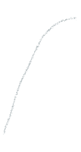
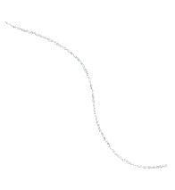
1. determine where f’(x) = 0
2. if f’(x) goes from positive to 0 to
negative, that’s a maximum point,
and if f’(x) goes from negative to 0
to positive, that’s a minimum point

Slide 11
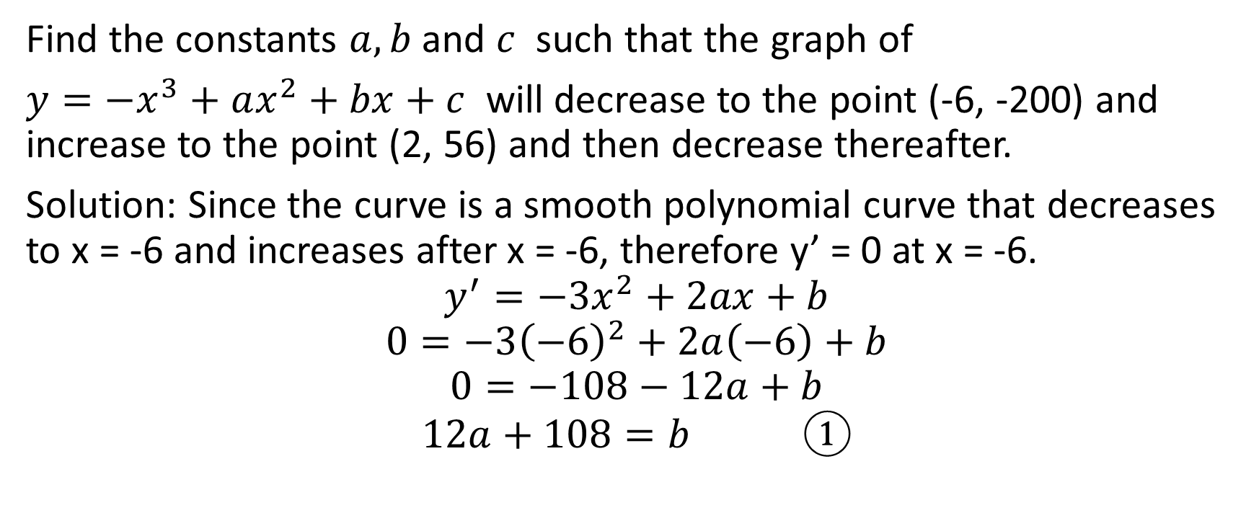
Example 3
Find the constants $a, b$ and $c$ such that the graph of
$y=−x^{3}+ax^{2}+bx+c$ will decrease to the point (-6, -200) and increase to the point (2, 56) and then decrease thereafter.
Solution: Since the curve is a smooth polynomial curve that decreases to x = -6 and increases after x = -6, therefore y’ = 0 at x = -6.
$$y^{′}=−3x^{2}+2ax+b$$
$$0=−3{\left(−6\right)}^{2}+2a\left(−6\right)+b$$
$$0=−108−12a+b$$
$$12a+108=b ①$$

Slide 12
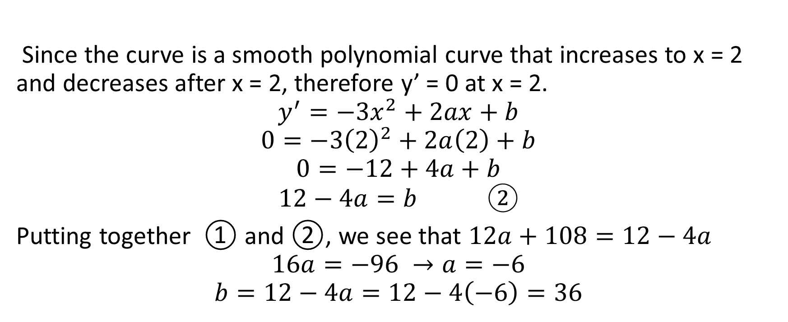
Since the curve is a smooth polynomial curve that increases to x = 2 and decreases after x = 2, therefore y’ = 0 at x = 2.
$$y^{′}=−3x^{2}+2ax+b$$
$$0=−3{\left(2\right)}^{2}+2a\left(2\right)+b$$
$$0=−12+4a+b$$
$$12−4a=b ②$$
Putting together ① and ②, we see that $12a+108=12−4a$
$$16a=−96 →a=−6$$
$$b=12−4a=12−4\left(−6\right)=36$$

Slide 13
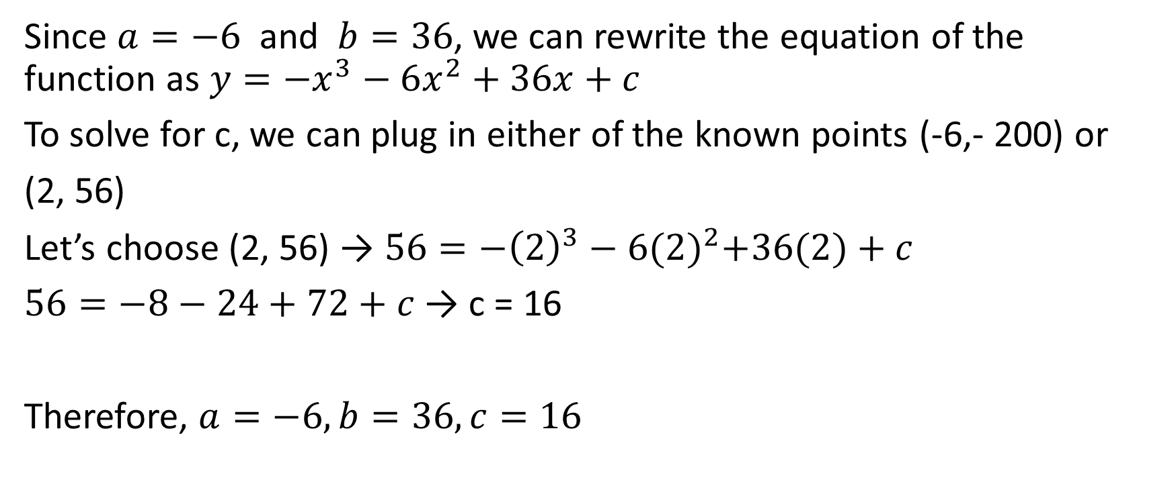
Since $a=−6$ and $b=36$, we can rewrite the equation of the function as $y=−x^{3}−6x^{2}+36x+c$
To solve for c, we can plug in either of the known points (-6,- 200) or
(2, 56)
Let’s choose (2, 56) → $56=−{\left(2\right)}^{3}−6{(2)}^{2}+36(2)+c$
$56=−8−24+72+c$ → c = 16
Therefore, $a=−6,b=36,c=16$

